Slide 1
Part II: How to Prepare a BDS Campaign
bdsmovement.net
uscpr.org/bdstoolkit

Slide 2
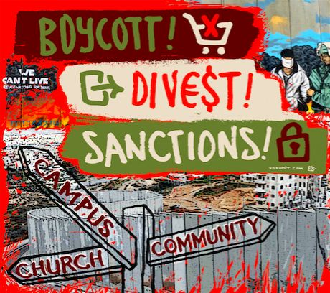

Slide 4
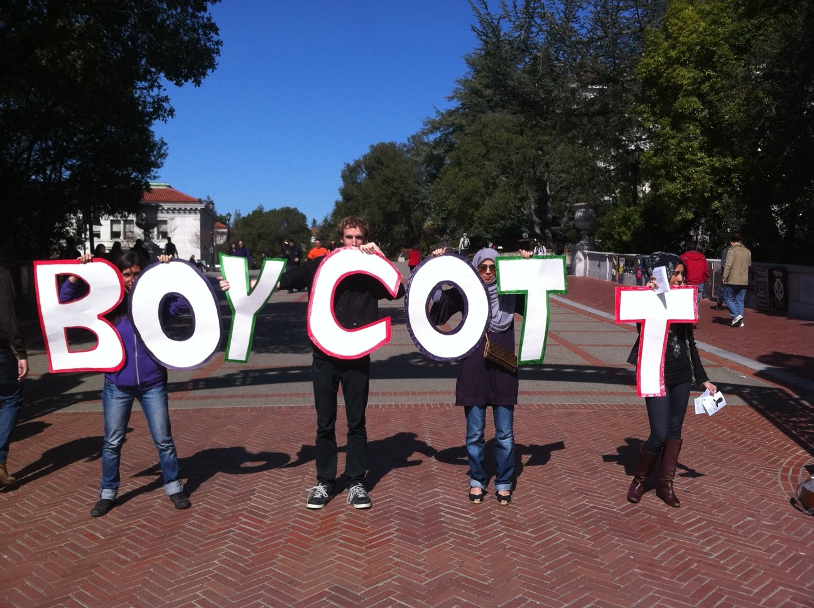

Slide 5
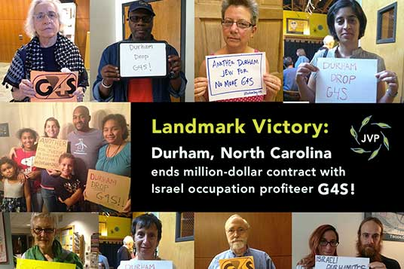
Types of Boycott Campaigns
Municipal Boycott

Slide 6
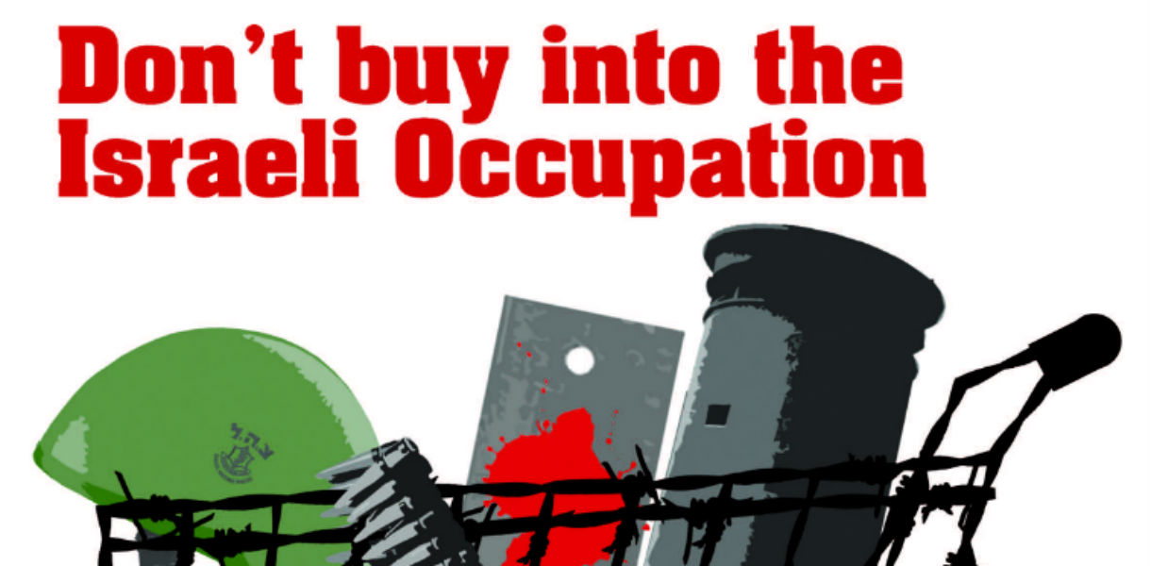
Types of Boycott Campaigns
Municipal Boycott
Consumer Boycott

Slide 7
Types of Boycott Campaigns
Municipal Boycott
Consumer Boycott

Slide 8
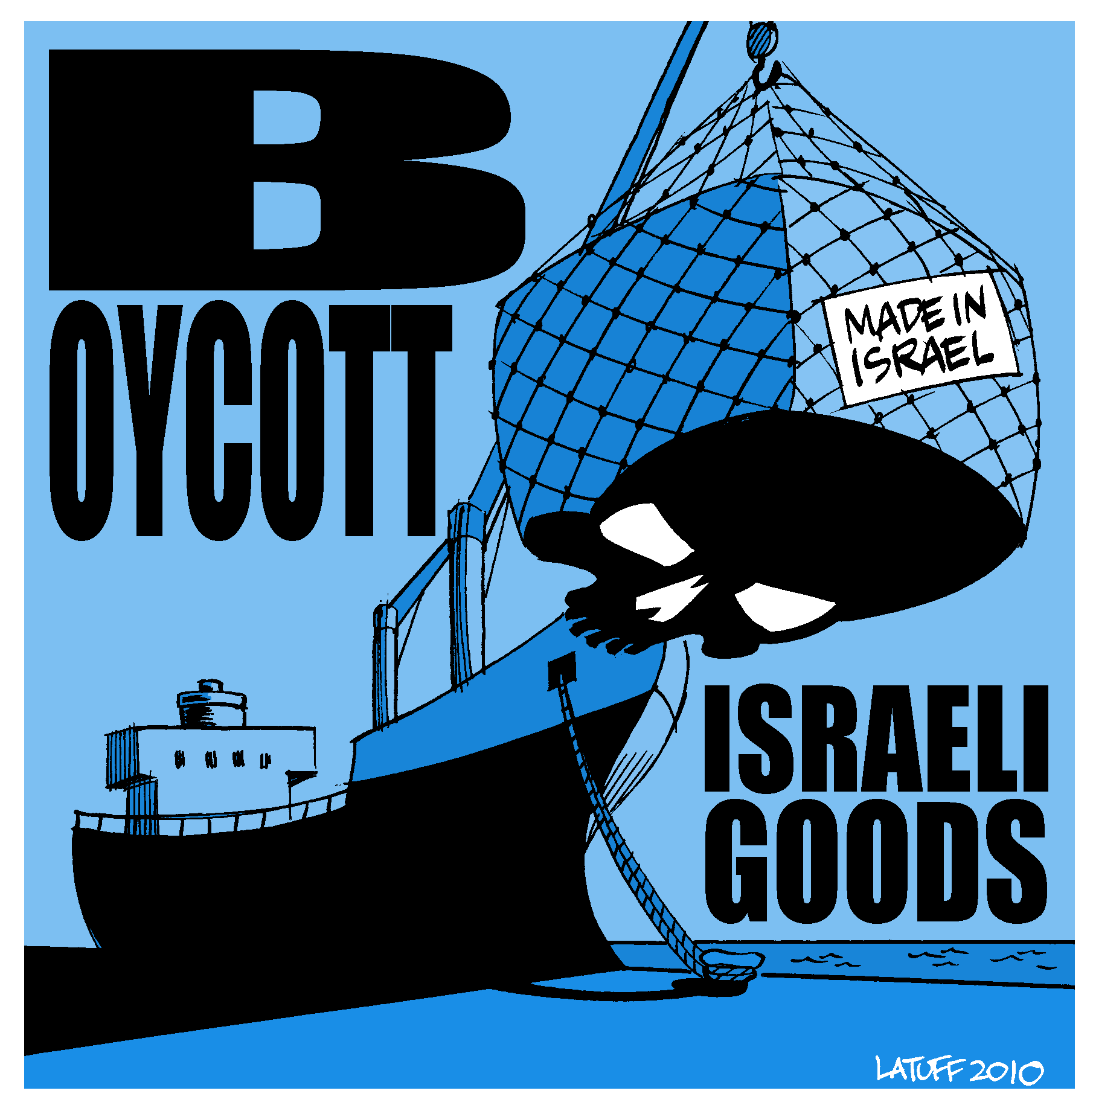
Types of Boycott Campaigns
Municipal Boycott
Consumer Boycott
Blocking Cargo

Slide 9
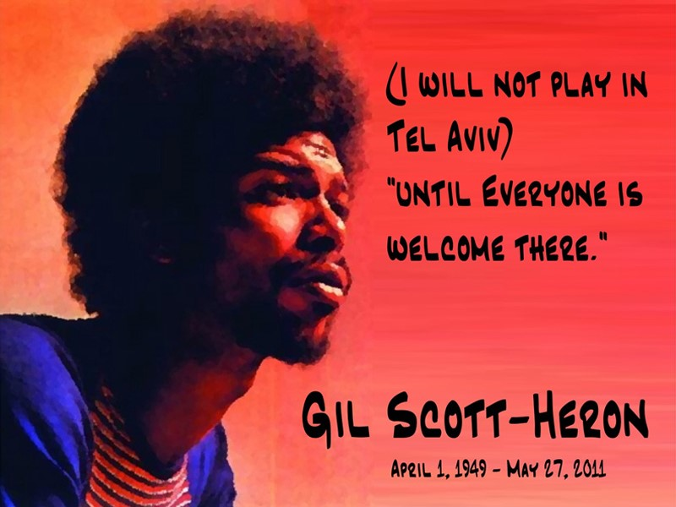
Types of Boycott Campaigns
Municipal Boycott
Consumer Boycott
Blocking Cargo
Cultural Boycott

Slide 10
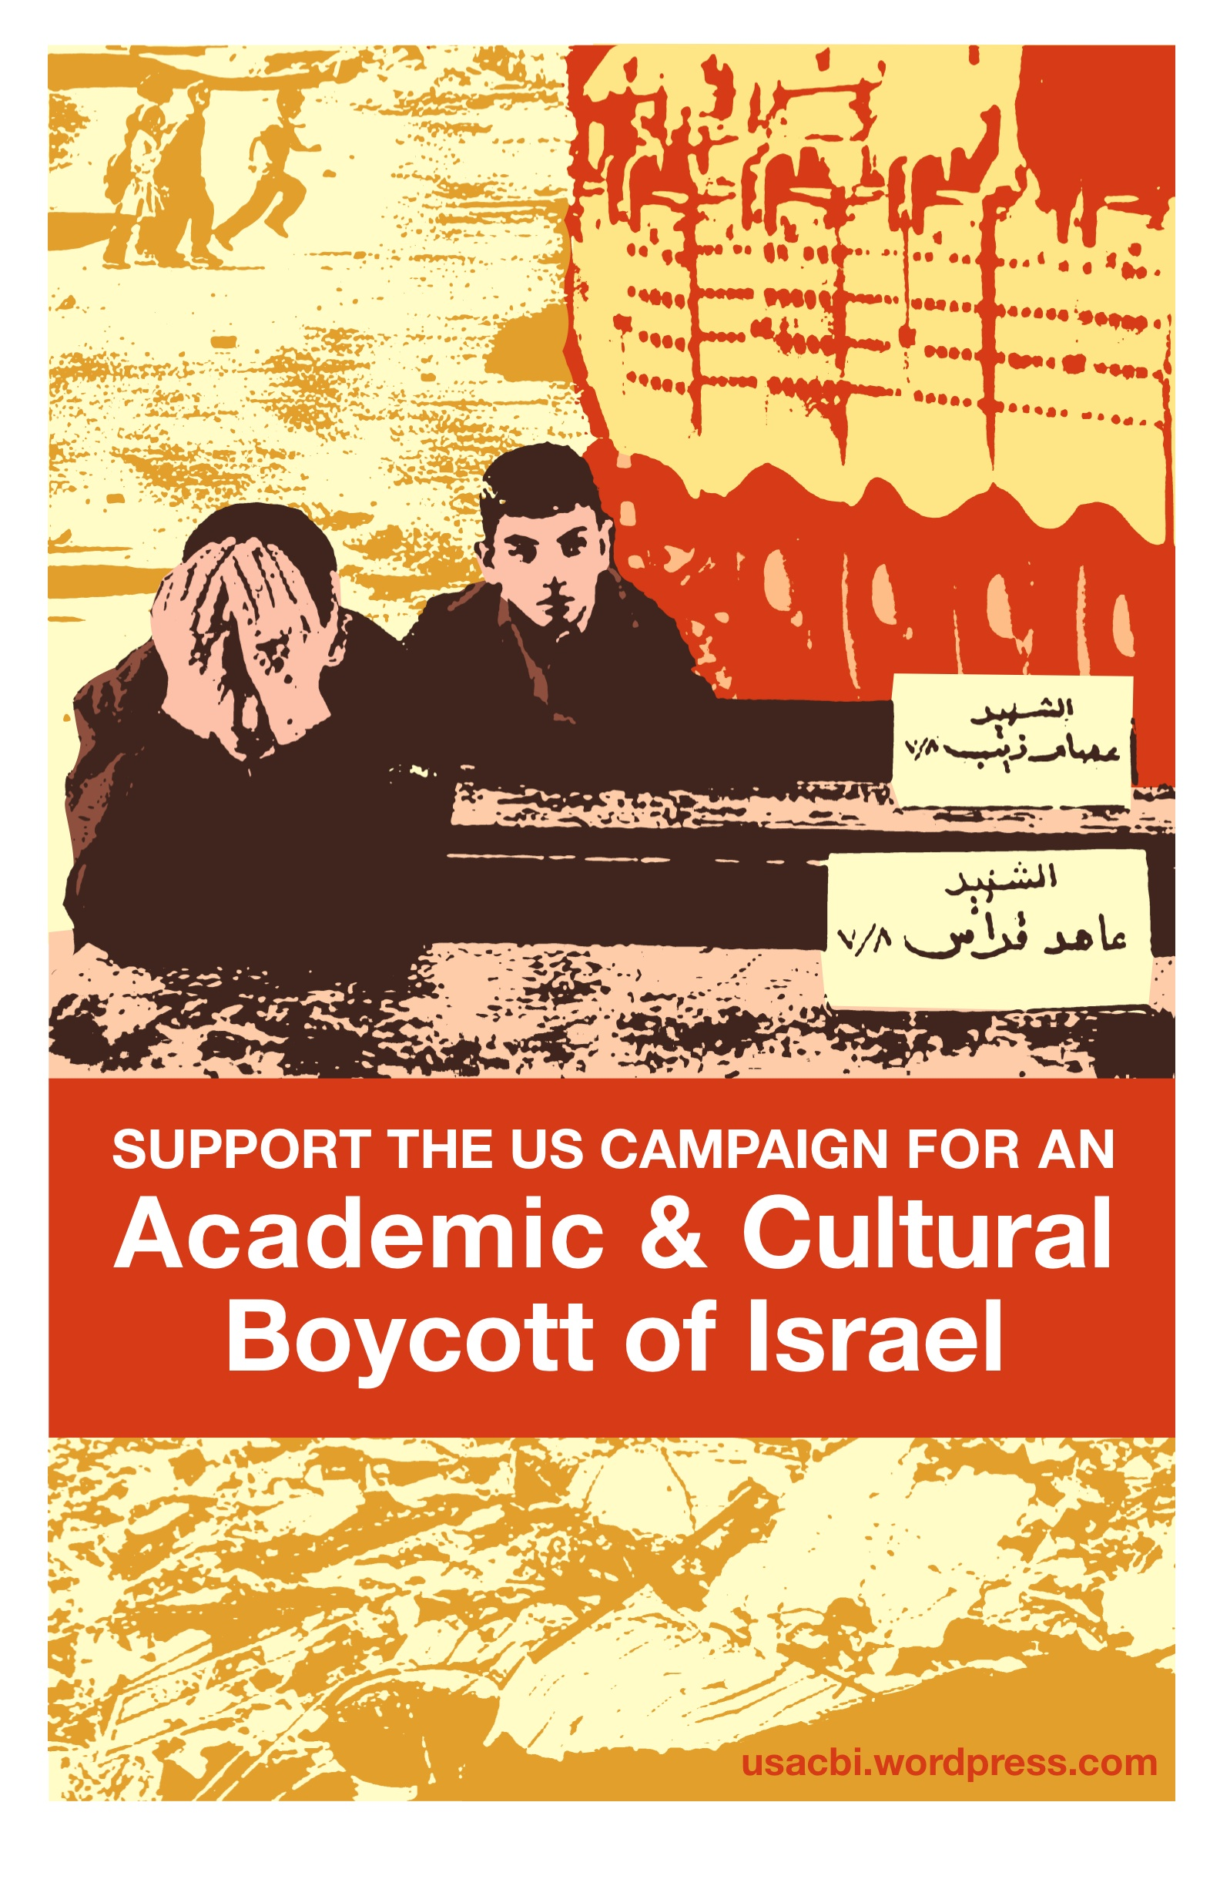
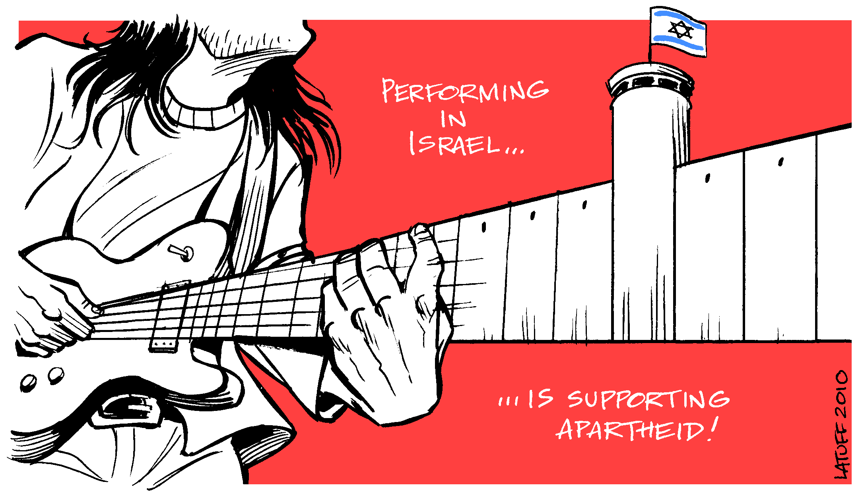
Types of Boycott Campaigns
Municipal Boycott
Consumer Boycott
Blocking Cargo
Cultural Boycott
Academic Boycott

Slide 11
Types of Boycott Campaigns
Municipal Boycott
Consumer Boycott
Blocking Cargo
Cultural Boycott
Academic Boycott
Sports Boycott

Slide 12
Types of Boycott Campaigns
Municipal Boycott
Consumer Boycott
Blocking Cargo
Cultural Boycott
Academic Boycott
Sports Boycott
Boycott Pinkwashing

Slide 13
Types of Boycott Campaigns
Municipal Boycott
Consumer Boycott
Blocking Cargo
Cultural Boycott
Academic Boycott
Sports Boycott
Boycott Pinkwashing
Boycott Greenwashing
Credit: Suhad Khatib

Slide 14
Types of Boycott Campaigns
Municipal Boycott
Consumer Boycott
Blocking Cargo
Cultural Boycott
Academic Boycott
Sports Boycott
Boycott Pinkwashing
Boycott Greenwashing
Anti-Normalization

Slide 15
Group-Building
Form your group before picking a campaign.
Establish a foundation of trust, common principles.
Center Palestinian leadership, youth, marginalized voices.
Read toolkit for tips on how to build healthy coalitions.
Talk about race, class, and gender.
Build and entrust new leaders.

Slide 16
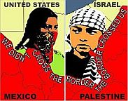
Picking a Campaign & Target
Research, Research, Research!
Visit afsc.org/investigate and whoprofits.org
BNC’s three guidelines for picking campaigns:
#1 – Potential for Success
#2 – Potential to Build Cross-Struggle Coalitions

Slide 17
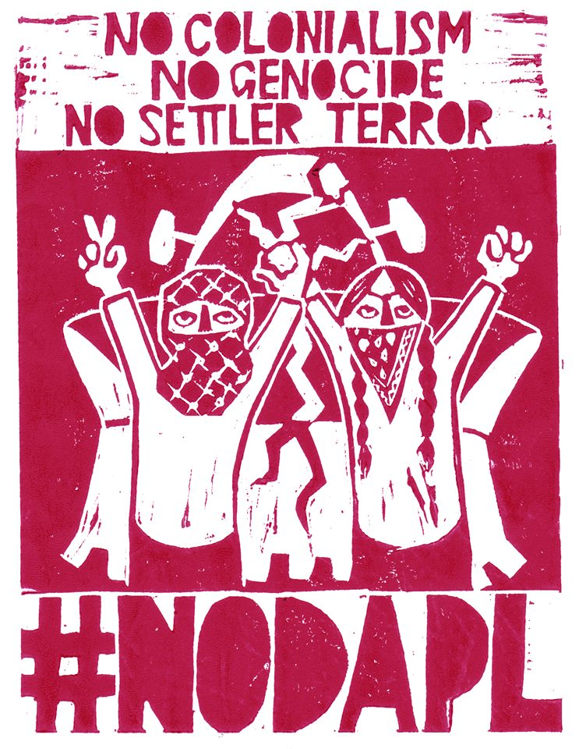
Credit: Leila Abdelrazaq

Slide 18
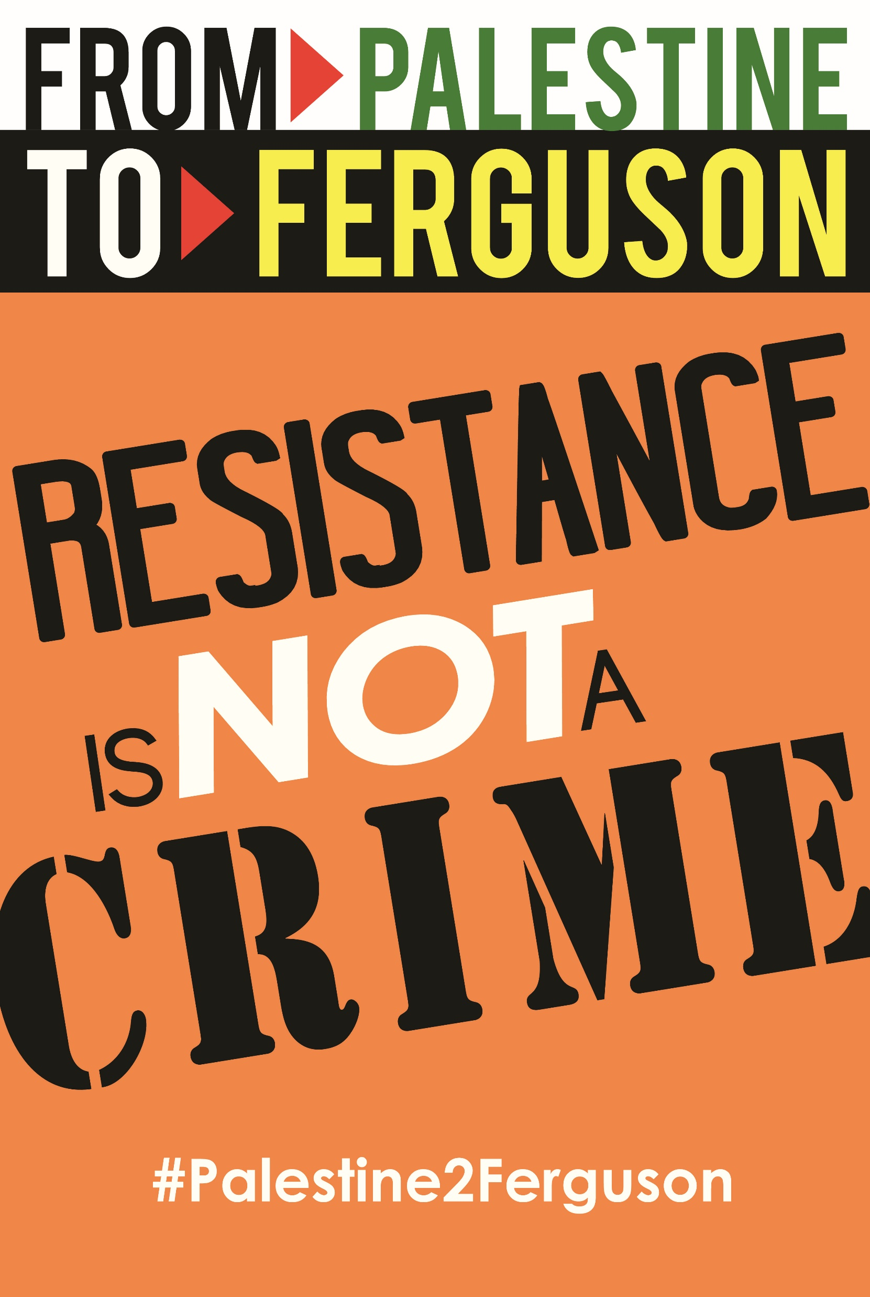
Credit: Yumna Ali

Slide 19
Credit: Leila Abdelrazaq

Slide 20
Picking a Campaign & Target
Research, Research, Research!
Visit afsc.org/investigate and whoprofits.org
BNC’s three guidelines for picking campaigns:
#1 – Potential for Success
#2 – Potential to Build Cross-Struggle Coalitions
#3 – Potential to Build Broad Support & Awareness
What campaigns are already out there?
Does it build power upwards?

Slide 21
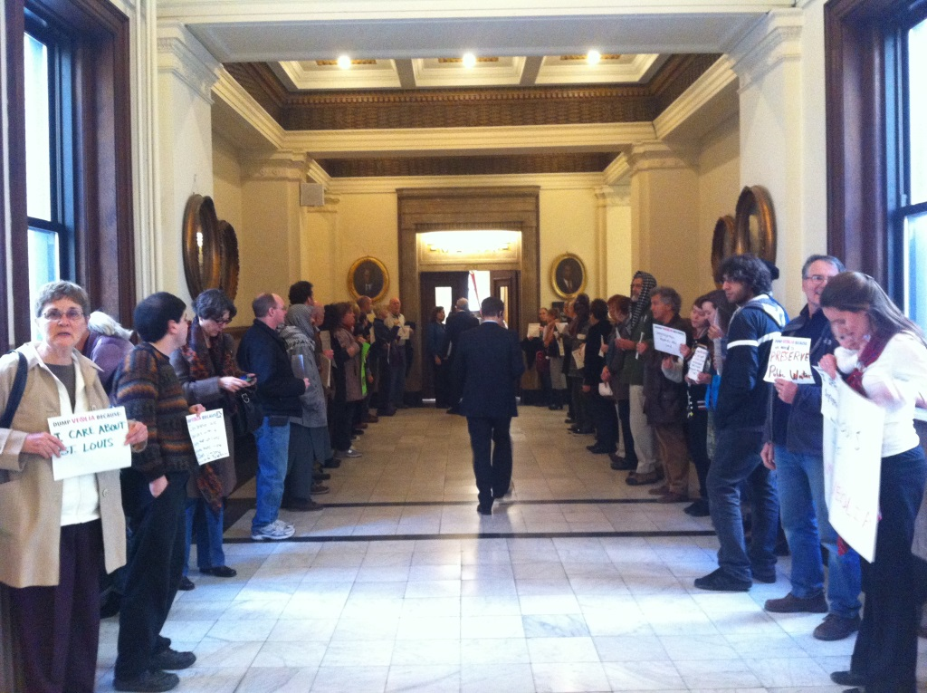

Slide 23
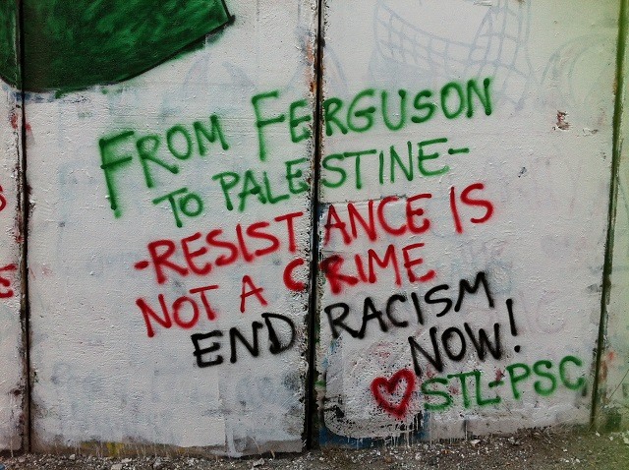
Preparing Your Campaign
Start with a soft ask
See resolution-writing tips
Reach out for endorsements

Slide 24
Preparing Your Campaign
Start with a soft ask
See resolution-writing tips
Reach out for endorsements
Get outside support

Slide 25
Preparing Your Campaign
Start with a soft ask
See resolution-writing tips
Reach out for endorsements
Get outside support
Map allies and opposition
Set Goals

Slide 26
Preparing Your Campaign
Start with a soft ask
See resolution-writing tips
Reach out for endorsements
Get outside support
Map allies and opposition
Set Goals
Timeline
Logo, website, social media, swag

Slide 27
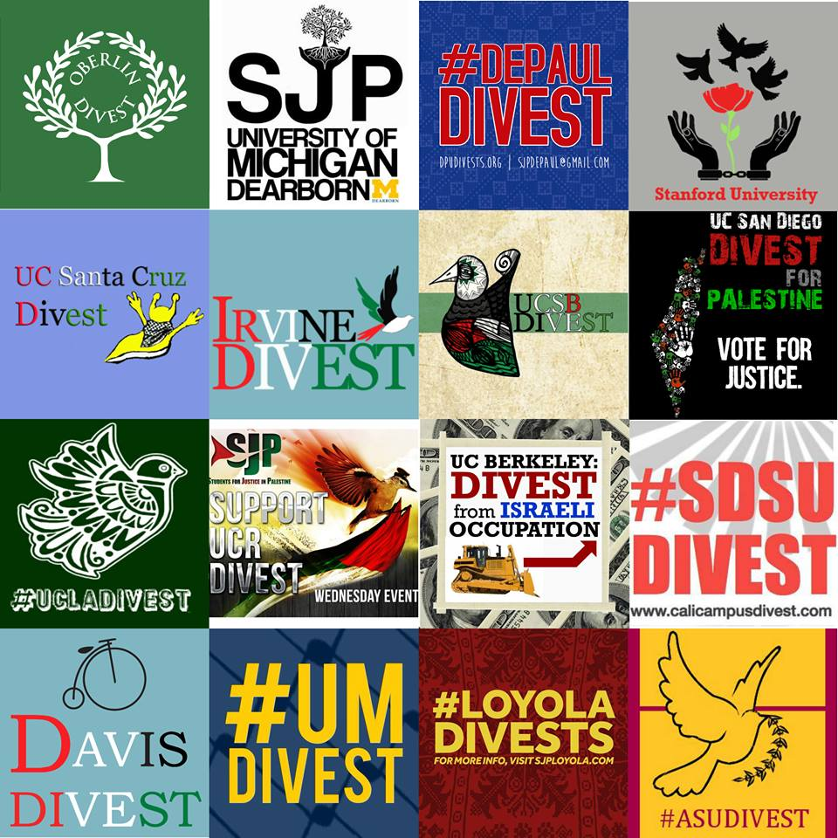

Slide 28
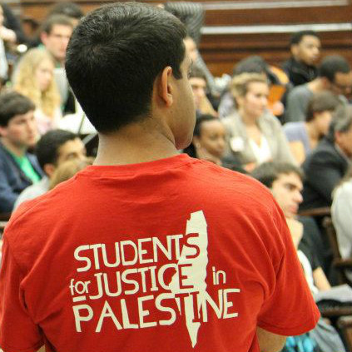

Slide 29
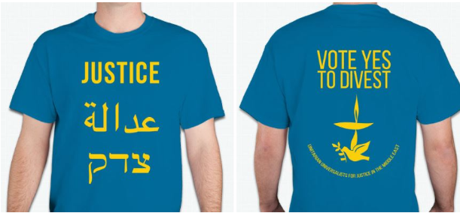

Slide 31
Part II: How to Prepare a BDS Campaign
bdsmovement.net
uscpr.org/bdstoolkit

Slide 32
Part II: How to Prepare a BDS Campaign
Part III: How to Win your BDS Campaign
bdsmovement.net
uscpr.org/bdstoolkit

