Slide 1
Part II: How to Prepare a BDS Campaign
Part III: How to Win your BDS Campaign
bdsmovement.net
uscpr.org/bdstoolkit

Slide 2
Checklist for Public Campaign Launch
Are you familiar with BDS guidelines?
Have a solid group of at least 5 people?
Have you show up across movements?
Have you done your research?
Have you reached out privately & respectfully to the target?
Have you mapped your goals & timeline?
Have your reached out for endorsements, outside support?
Have a first resolution draft ready? (if applicable)
Website, Facebook, Twitter accounts ready?
Upcoming events where people can learn more & plug in?

Slide 3
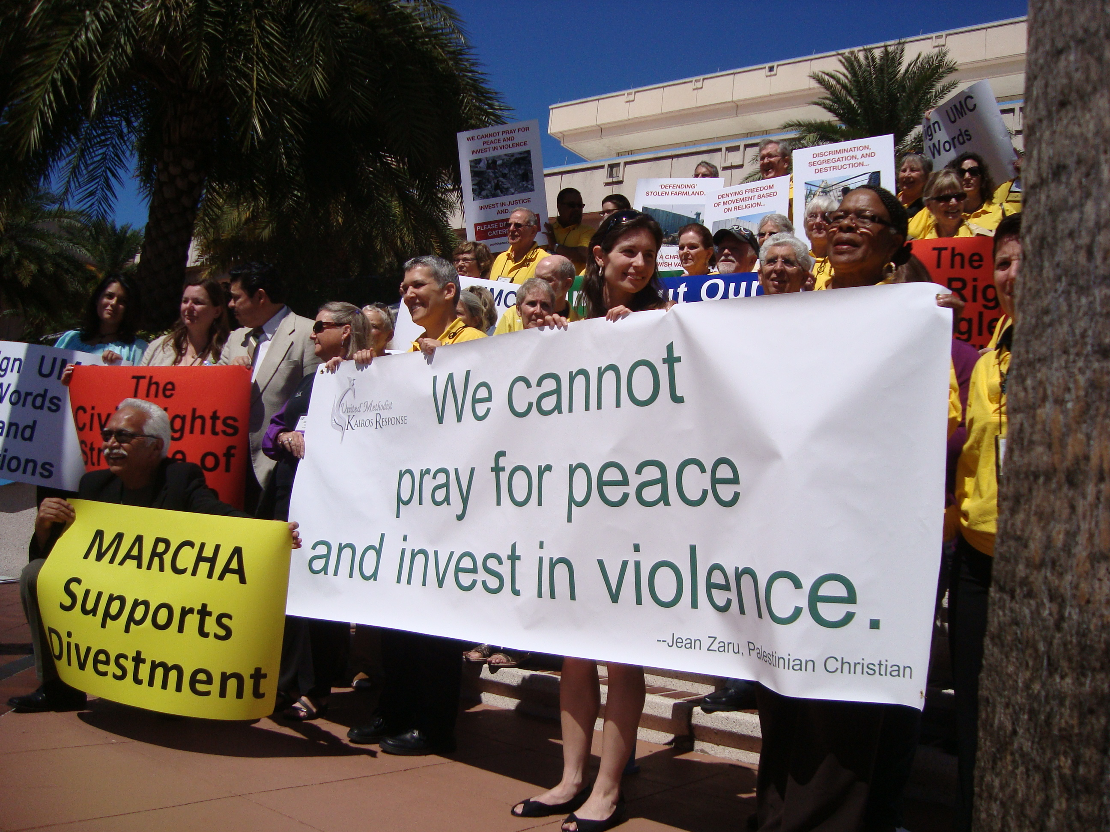
Press Release, Press Conference, Photo Op

Slide 4
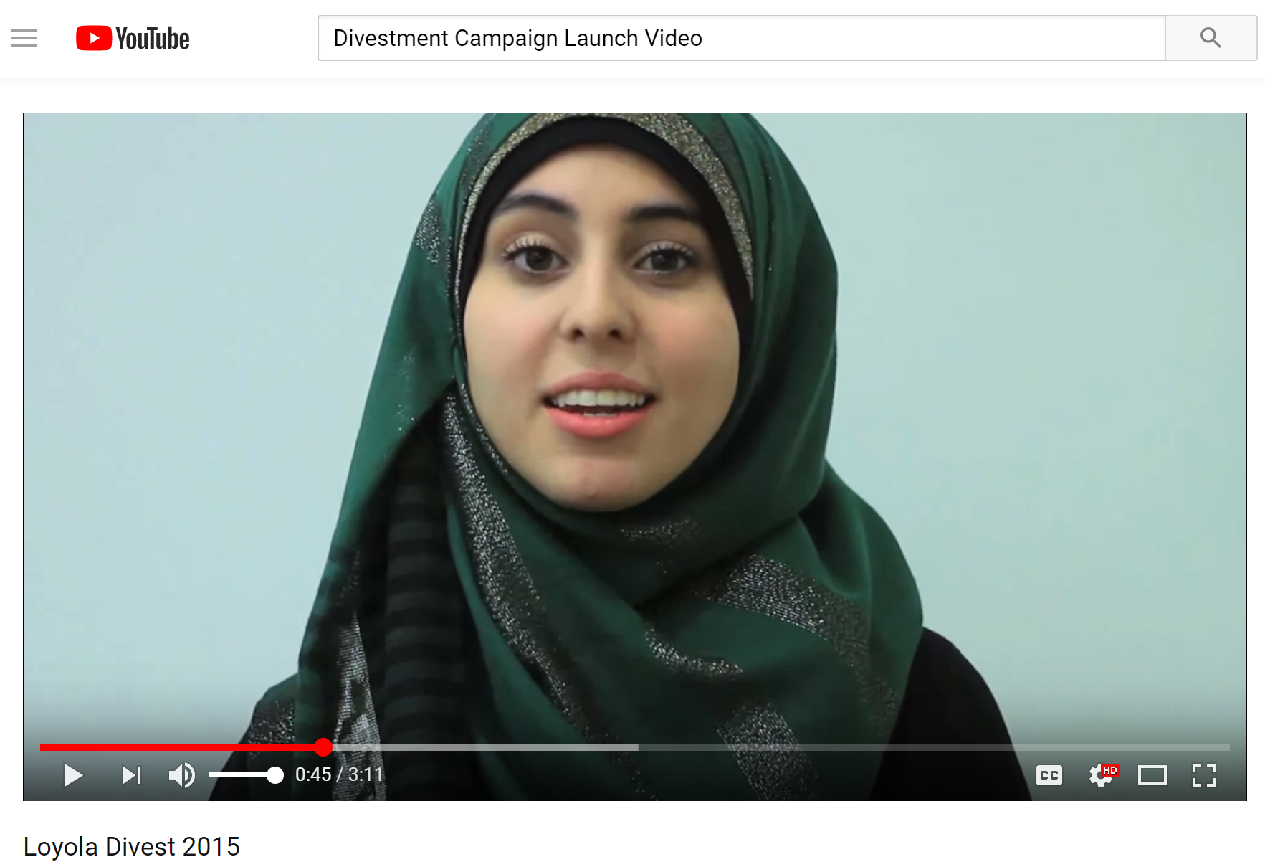
Launch Video

Slide 5
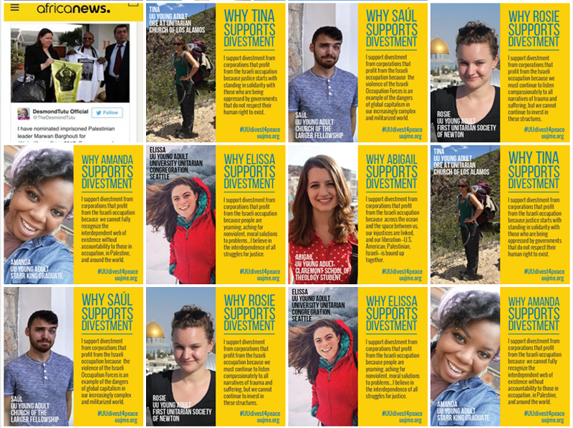
Social Media Splash

Slide 7
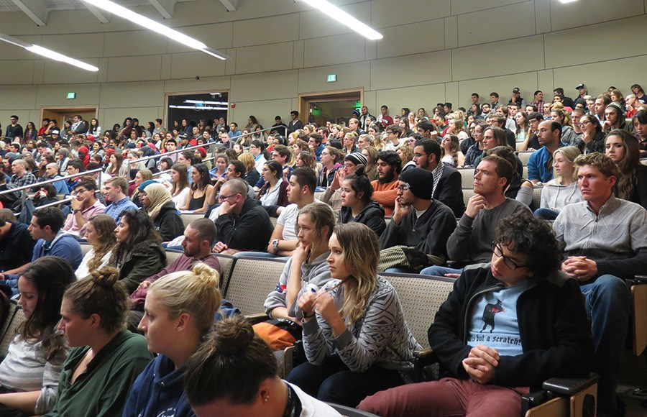
Host an Informational Event

Slide 8
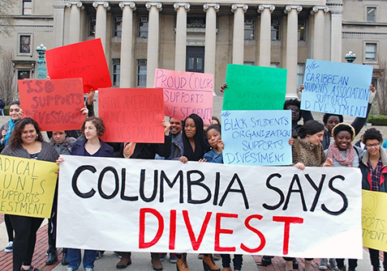
Be Visible!

Slide 9
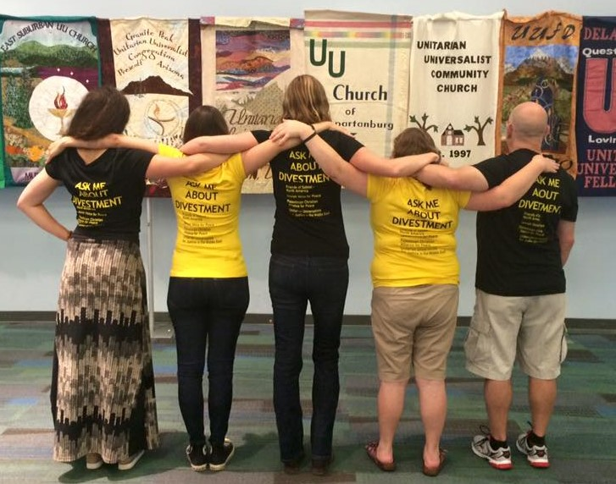
Be Visible!

Slide 10
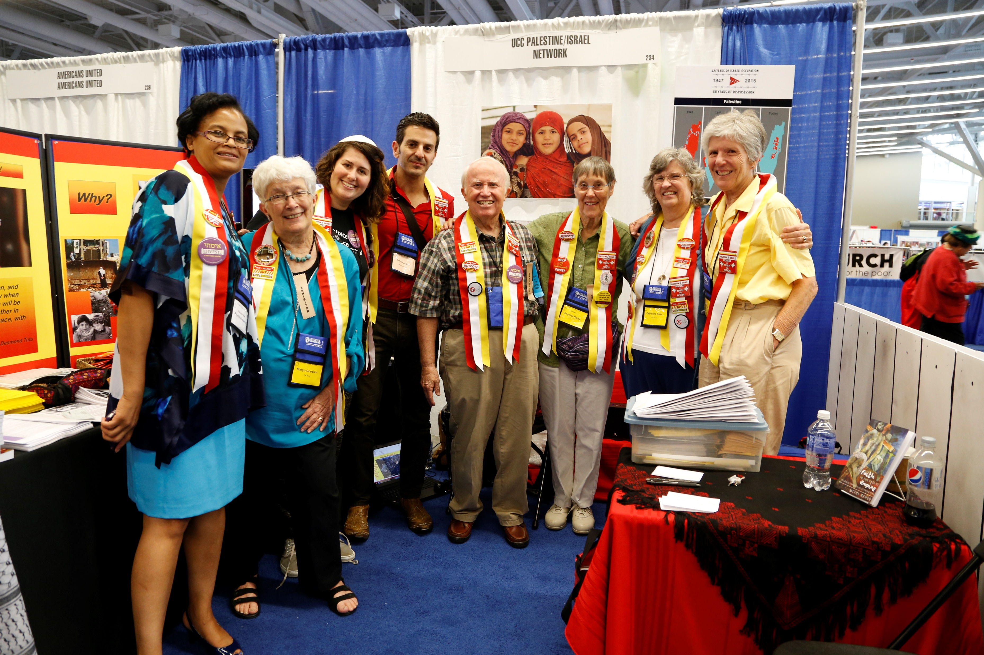
Be Visible!

Slide 11
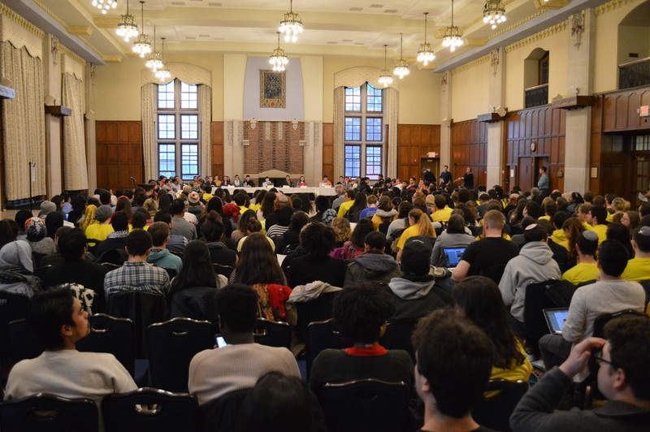

Slide 12
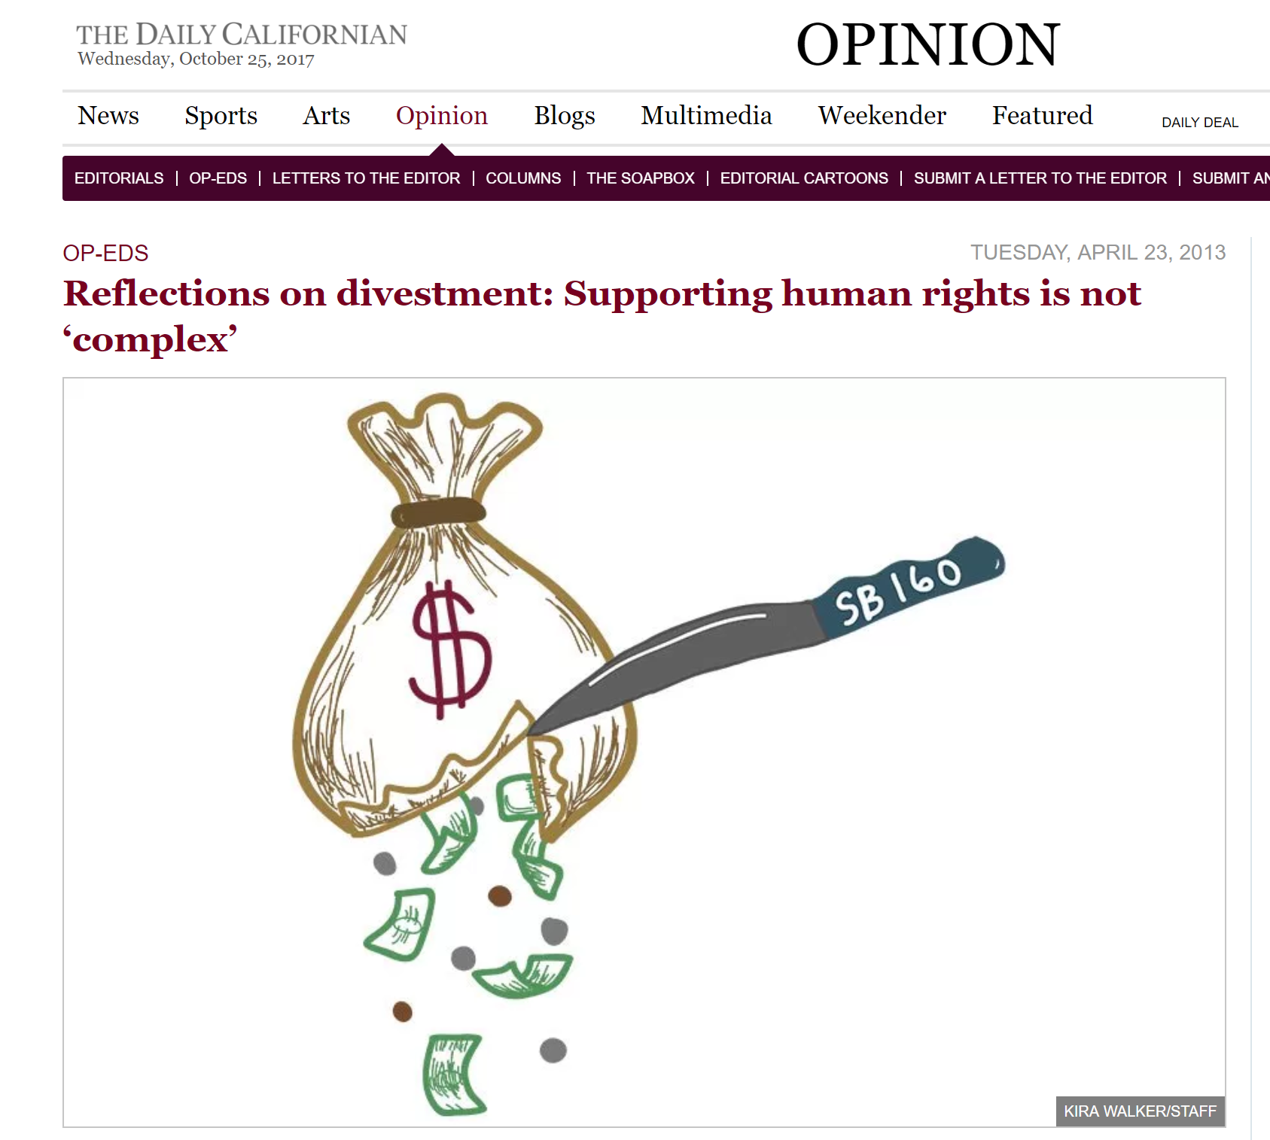

Slide 13
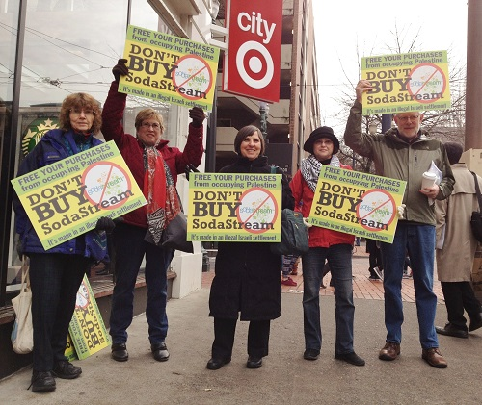

Slide 15
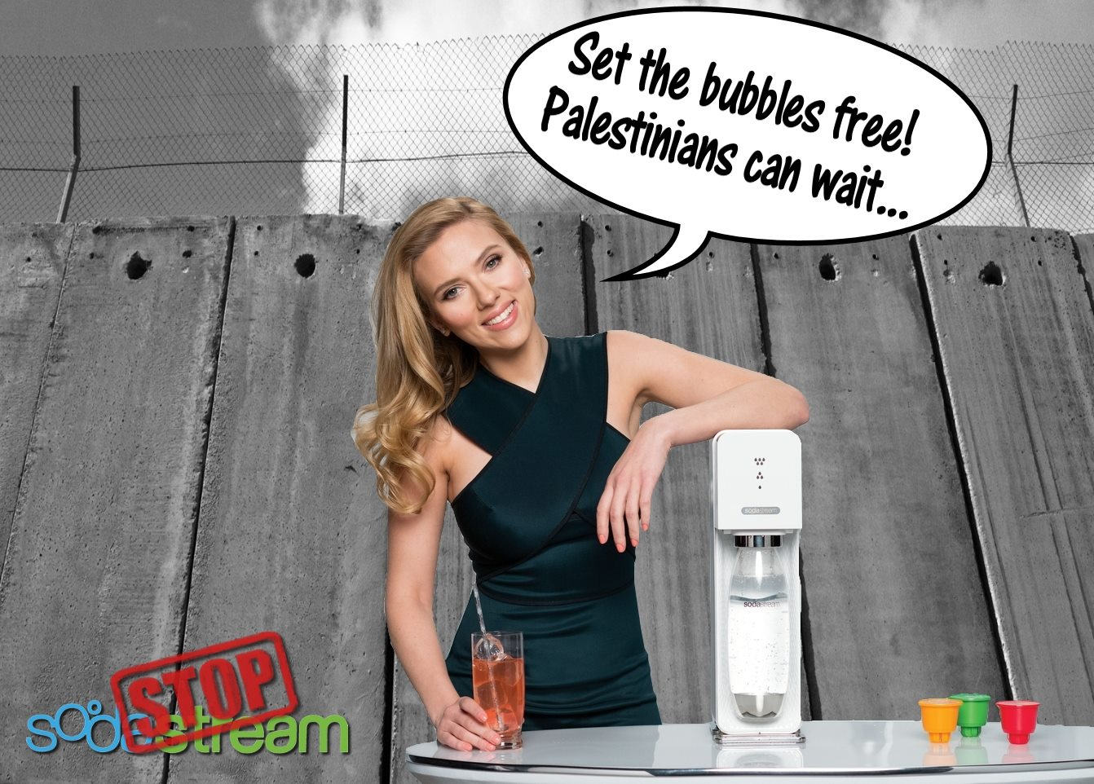

Slide 18
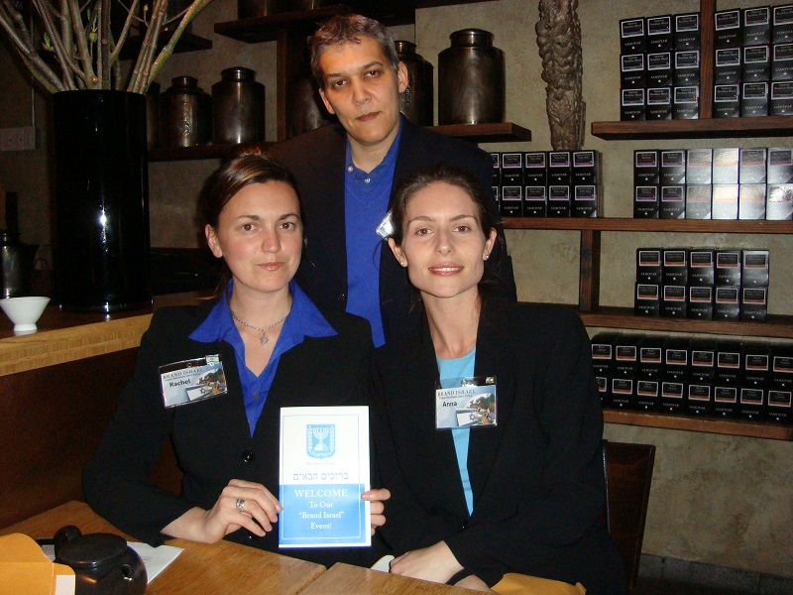

Slide 19
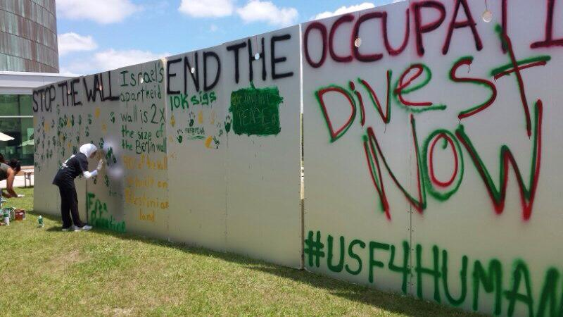

Slide 20
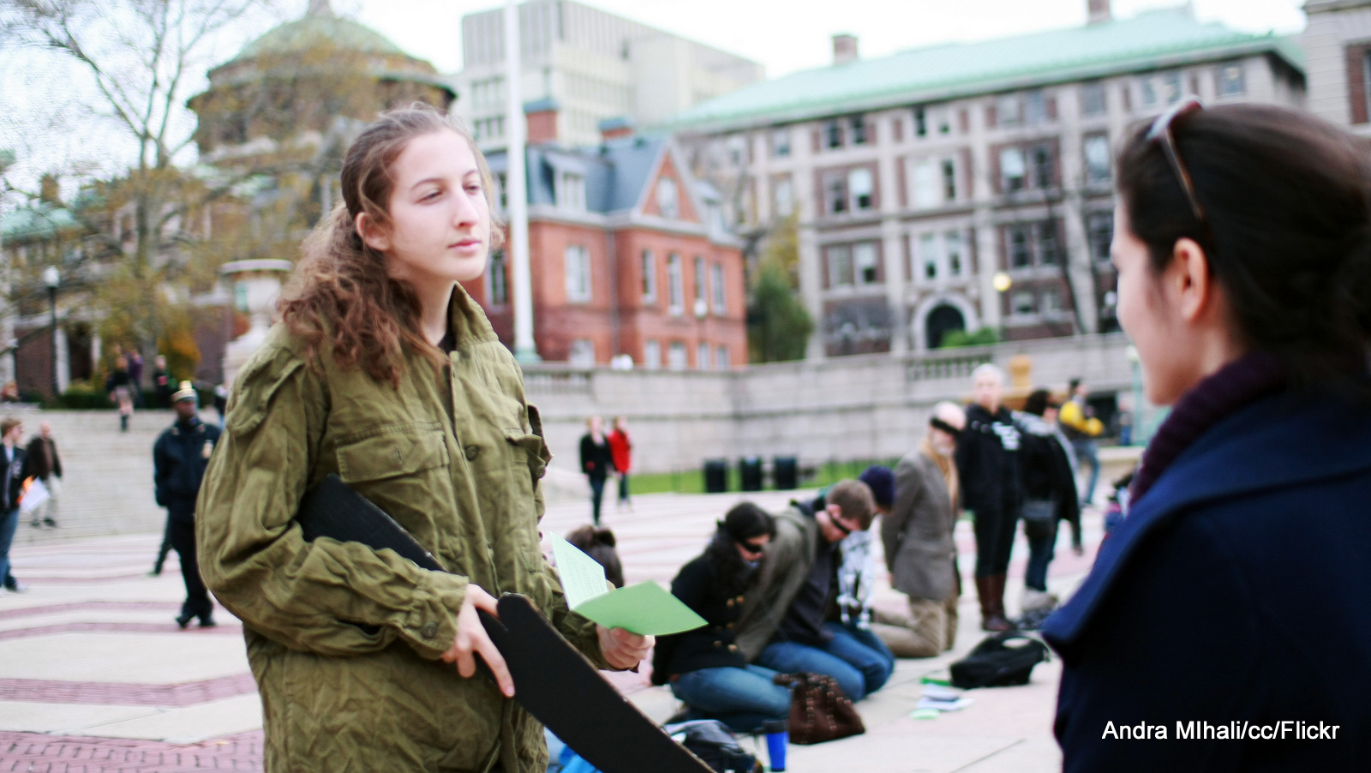

Slide 21
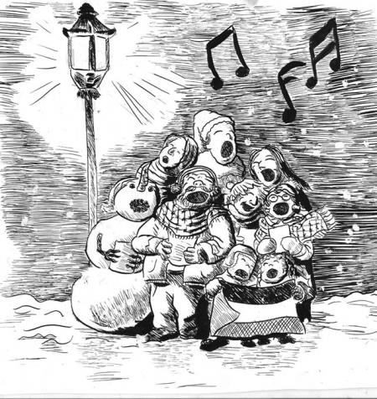

Slide 22
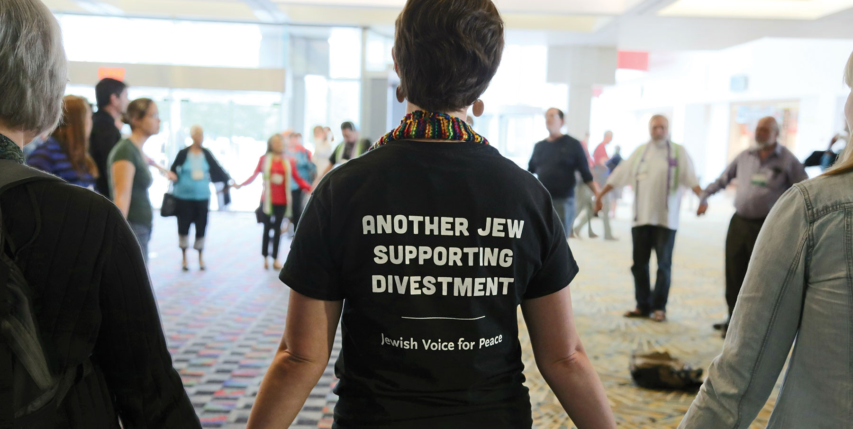

Slide 23
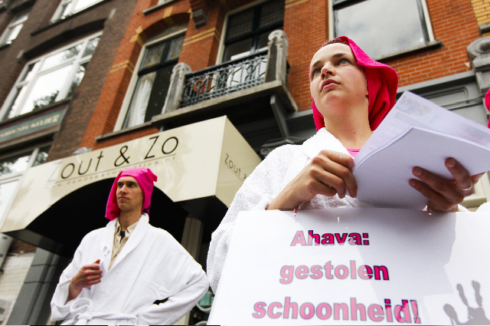
Notes:
The Dutch Bathrobes Brigade inspired activists in the U.S. to start using spa attire at cold weather protests.

Slide 24
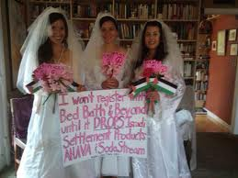

Slide 25
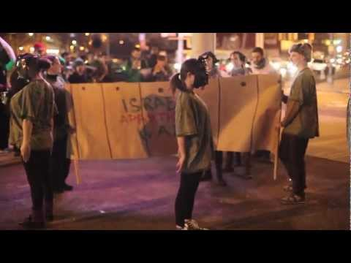

Slide 26
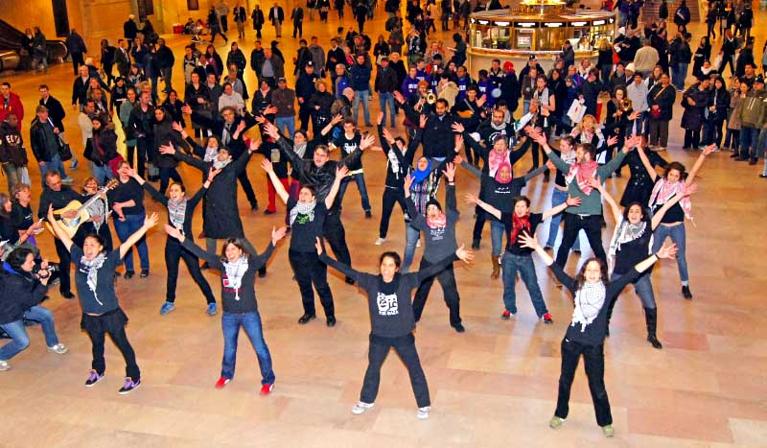

Slide 28
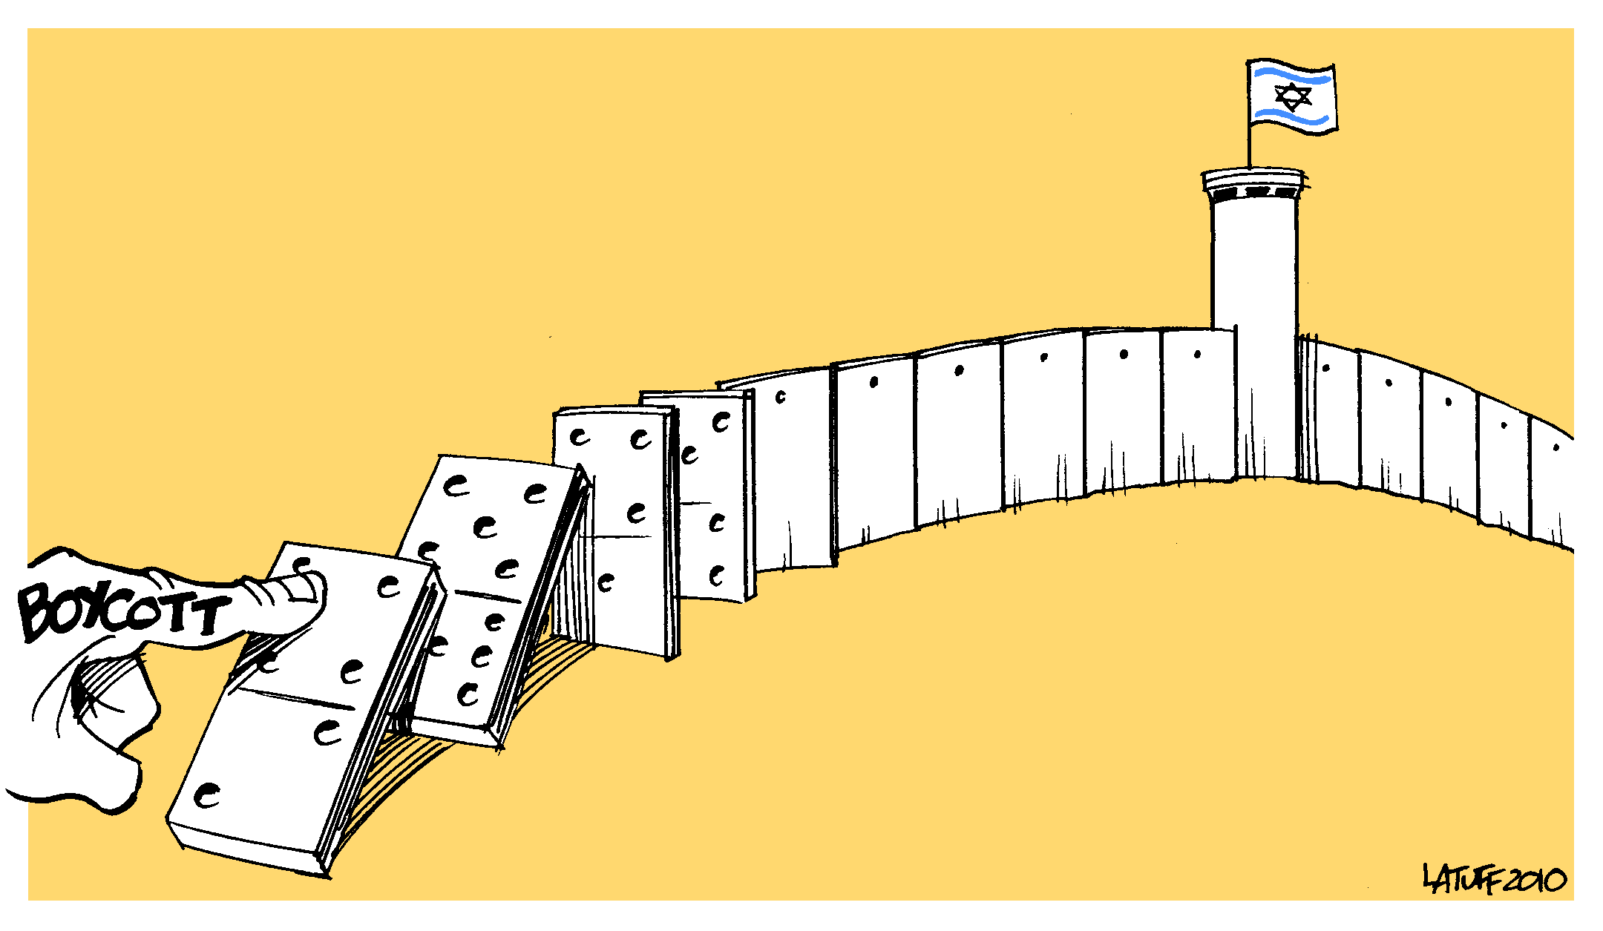

Slide 29
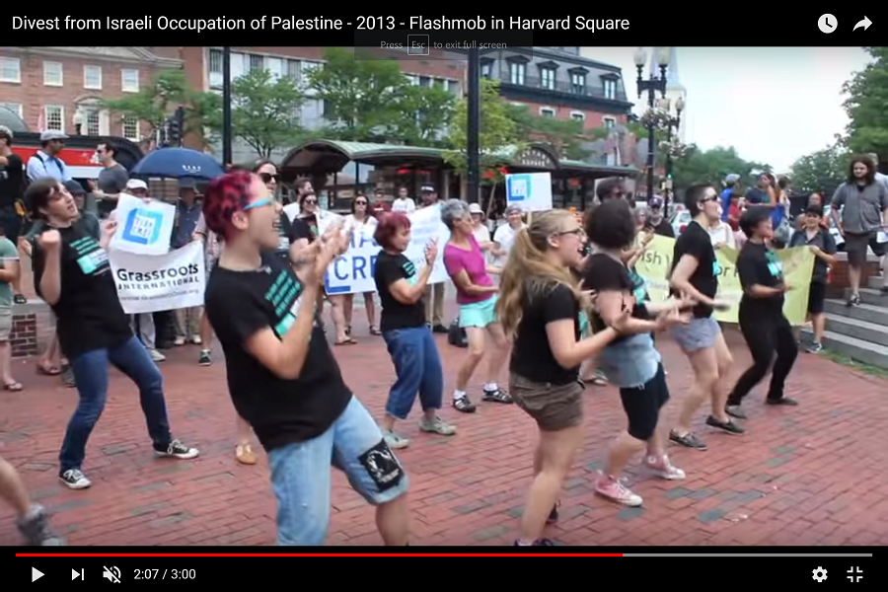

Slide 30
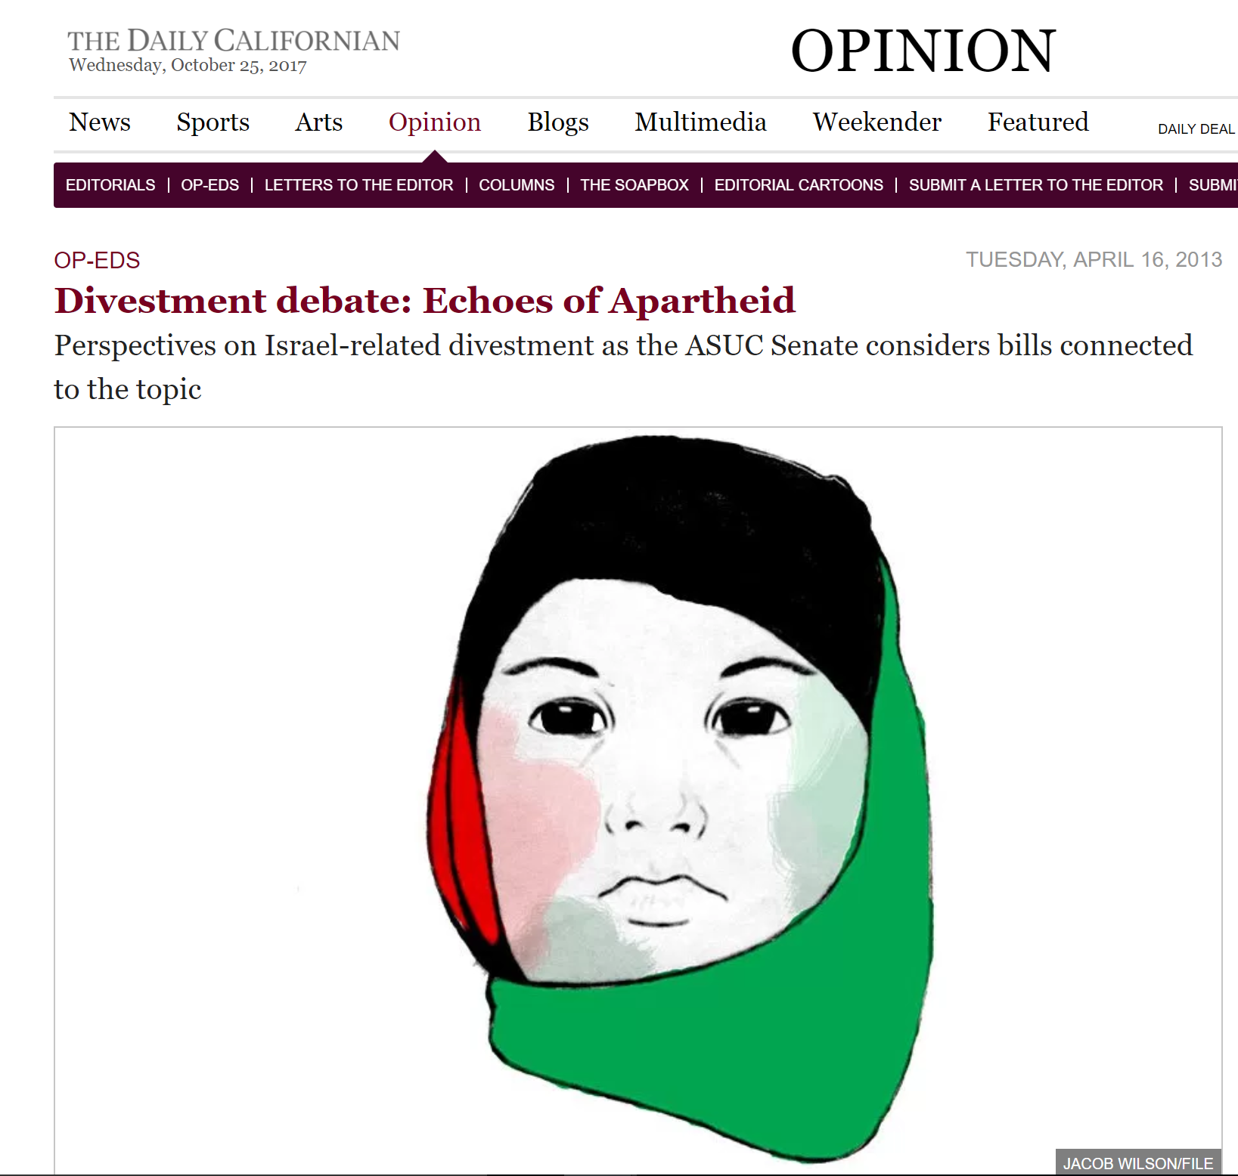

Slide 31
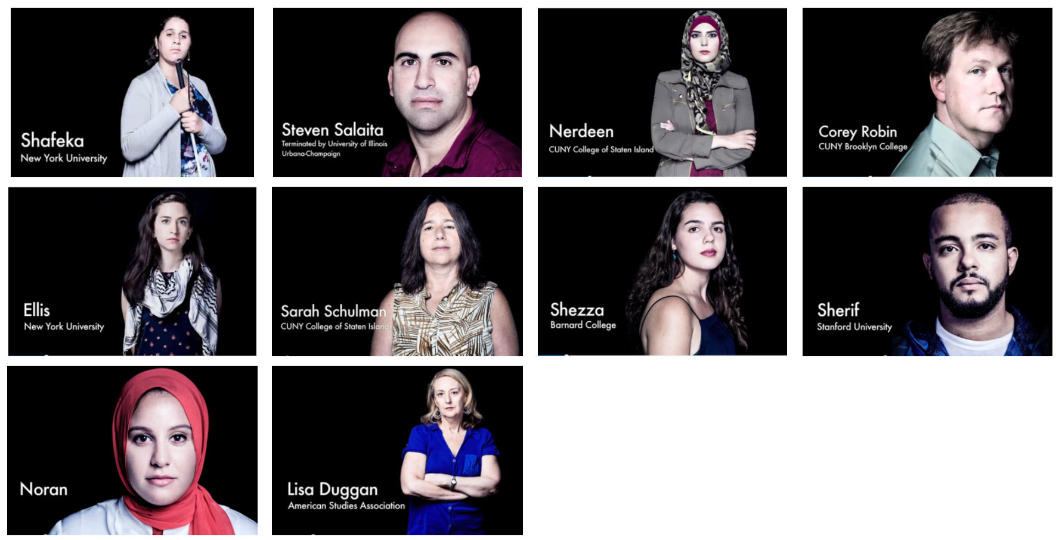

Slide 33
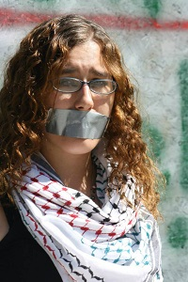

Slide 35
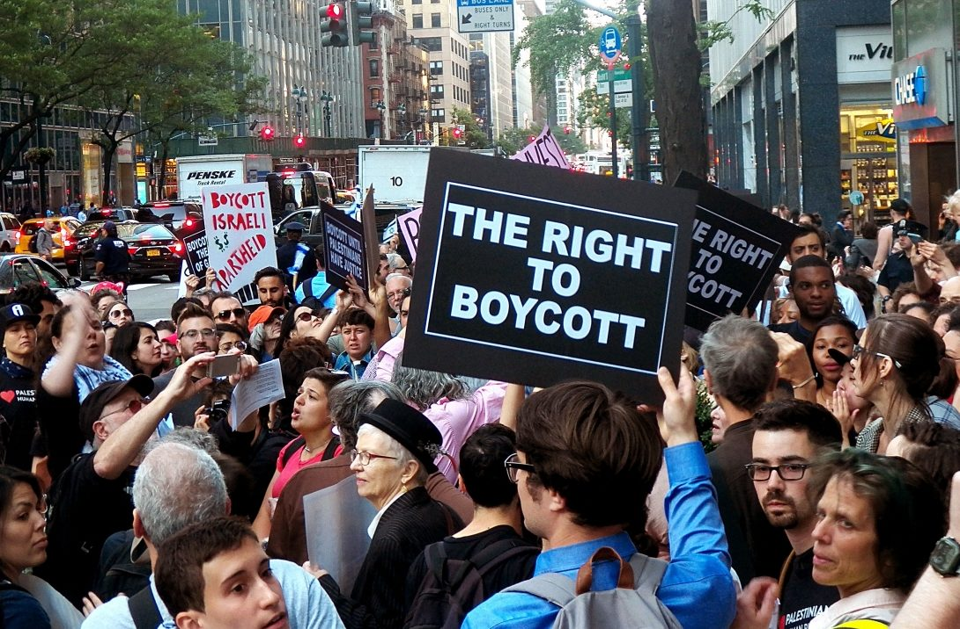

Slide 36
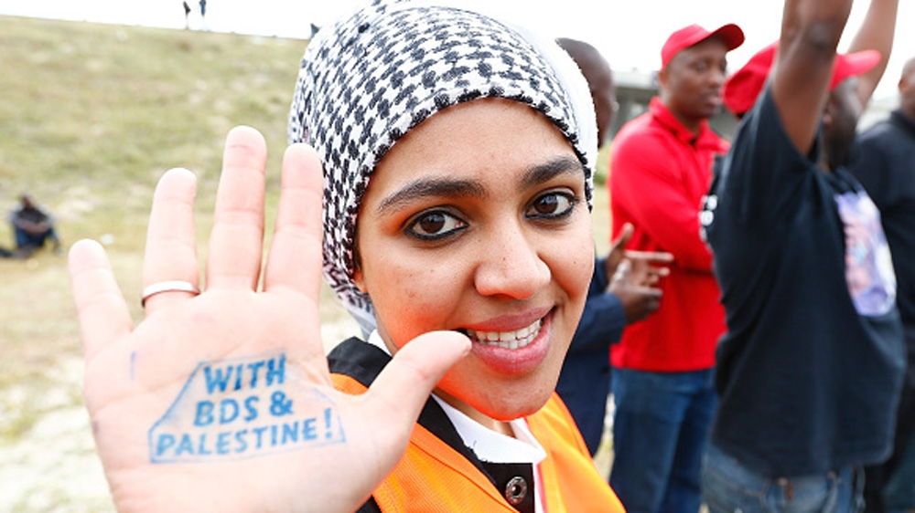

Slide 37
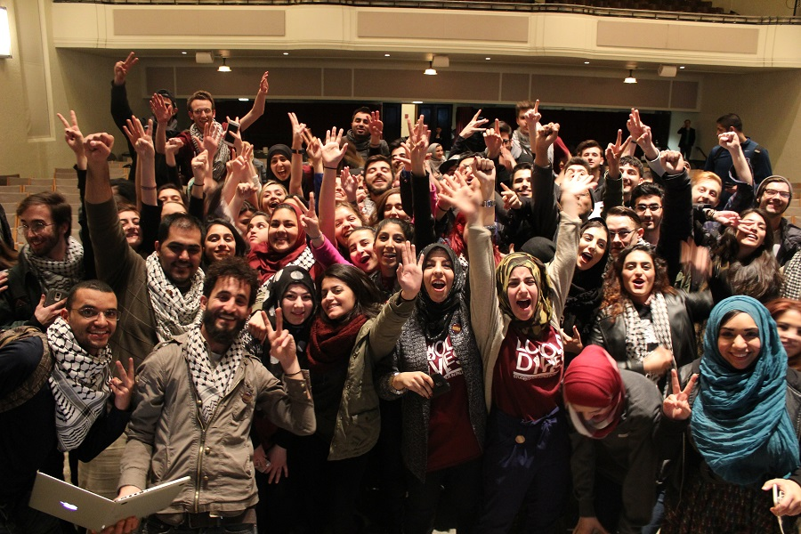

Slide 38
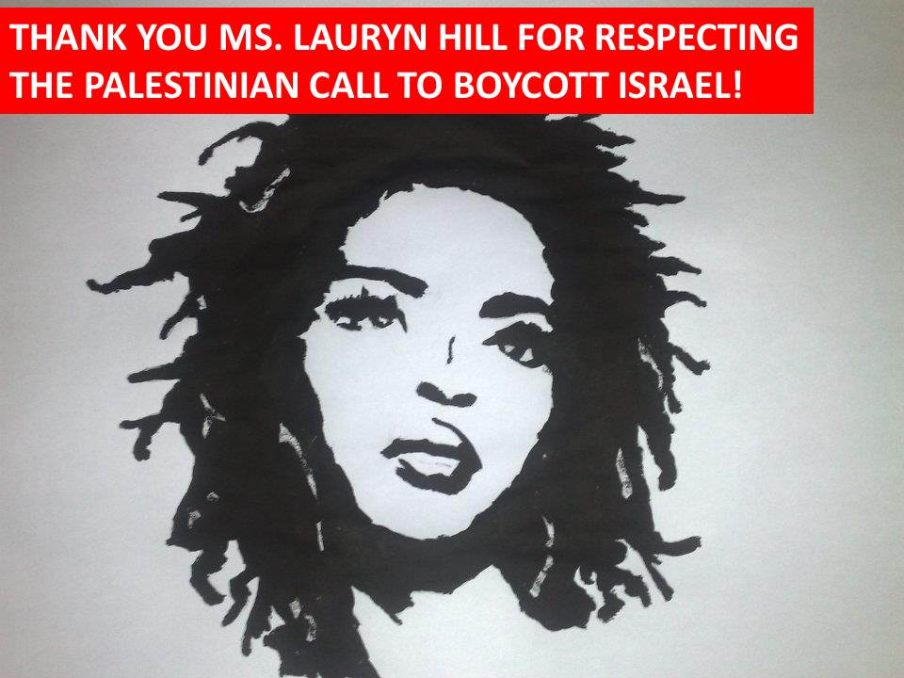
You Won!
Celebrate!
Press Release, Press Conference
Connect to the global movement
Inform the BNC & USCPR
Reinforce your win
Debrief lessons learned
Continue building power

Slide 39
Part II: How to Prepare a BDS Campaign
Share these videos with your friends!
bdsmovement.net
uscpr.org/bdstoolkit

